Slide 1
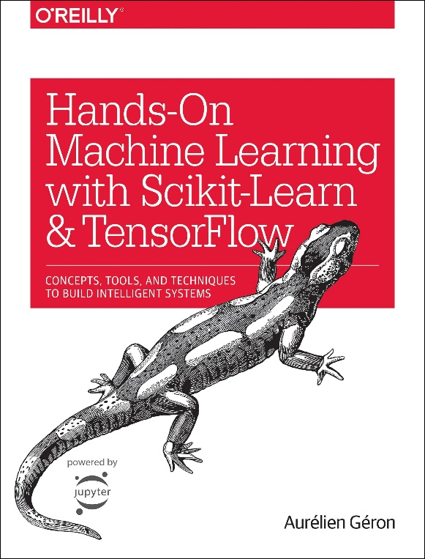

Novice Machine Learning E2E Project
Part 01
Look at the Big picture
Mukunthan Ragavan

Slide 2
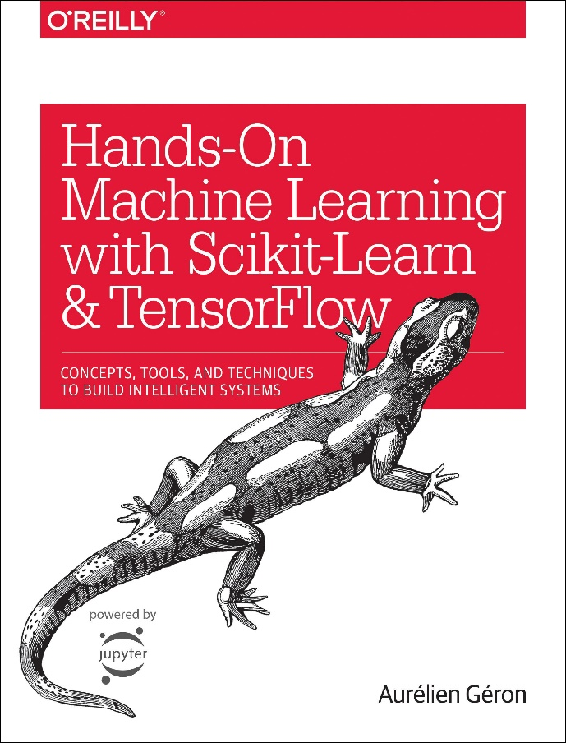
Few points on this Book !
Best book that has perfect blending theory concepts and
more practical with popular libraries and tools.
Step by step, pipelines of ML E2E Project.
Detailed checklist of typical ML Project.
Almost all main topics such as Training models, Classification,
SVM, Decision trees, Ensemble Learning, Dimensionality
reduction.
Covers Neural networks (CNN, RNN) and Deep Learning
as well.
And best book to start with this if you want book that represents
Sample of ML concepts with practical exclusively.

Slide 3
E2E Machine Learning Project
Look at the Big picture.
Get the Data.
Discover and visualize the data to get insights.
Prepare the data for ML algorithms.
Select a model to train it.
Fine-tune your model.
Present your solution.
Launch, monitor and maintain your system.

Slide 4
Look at the big picture !

Slide 5
Business objective
Business objective : Prediction of a district’s median housing price based on the existing data of housing prices of different districts with extra other inputs. Basically we have various inputs and its output.
Benefit: Later stage, this prediction will determine the whether it is worth to invest in a particular district or not.
Hence, Supervised learning (batch learning) with linear multivariate regression model as it is confirmed that business need prediction in prices, not in classification.
Performance measure as Root Mean square Error (RMSE) for the model.

Slide 6
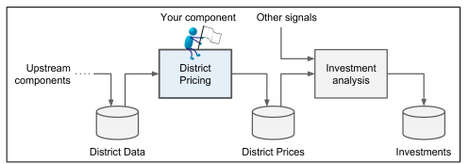
Overall Big Picture !
Hands-on Machine Learning with Scikit-Learn, Keras, and TensorFlow Concepts, Tools, and Techniques to Build Intelligent Systems
- Aurélien Géron

Slide 7
Thanks All for watching and your subscription !

